Slide 1
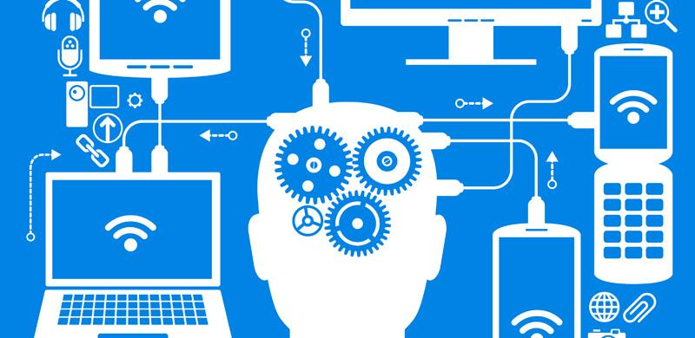
GE1155- Computer in Education
LEARNING
ABOUT ICT
Group 2:
Siti Shakirah Bt Sayadi A152746
Nur Shazana Bt M.Ibrahim A156307
Ivy Elmira anak Jeri A156104

Slide 2
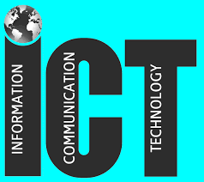
What is ICT (in general)?
ICT stands for Information and Communication Technology/technologies.
According to Blurton (2002), ICT is the diverse set of technological tools and resources used to communicate, and to create, disseminate, store and manage information.
It includes: 1) Computers
2) Internet and Network
3) Broadcasting technologies (Radio and Television)
4) Telephony

Slide 3
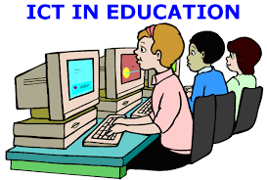
What is ICT in Education?
ICT in Education means “Teaching and Learning with ICT”
Potentially powerful enabling tools for educational changes and reform.
Different ICTs can help in:
Expanding the access to education
Strengthen the relevance of education with digital workplace.
Raise educational quality.

Slide 4
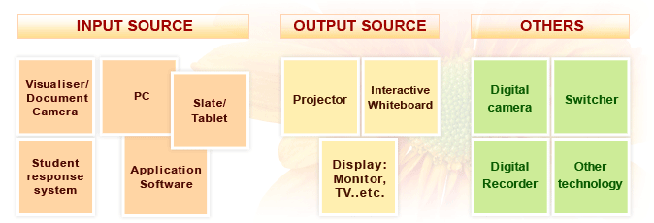
Educational ICT Tools:

Slide 7
Types of Learning with ICTs
E-Learning
Blended Learning
Open/Distance Learning
Lifelong Learning

Slide 8
E-Learning
Also known as online learning
Learning using Internet for course delivery, interaction, evaluation or facilitation
Blended Learning
Combination of traditional class and e-learning
Learning is not all best achieved in only electronically-mediated environment

Slide 9
Open/ Distance Learning
Learning with the use of medias, that requires two-way communications which allows interaction between learners and tutors
Students and teachers are separated; time and place
Certified by an institution or agency
Lifelong Learning
Self-independent learning (formal and informal)
The ongoing, voluntary and self-motivated pursuit of knowledge for either personal or professional reasons.
Online courses are offered for free by many institutions

Slide 10
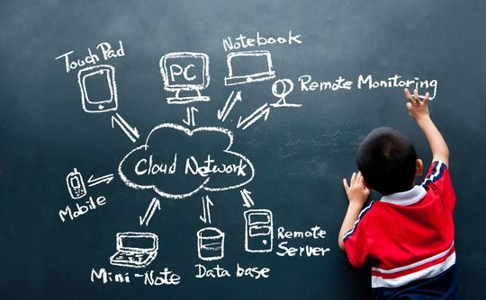
To do task/assignments.
Interactive learning process via multimedia materials
Improve teaching; video conferencing, digital video and virtual learning environments
Tool
Roles of ICT
Computer takes over the role of a teacher
Internet provides variety of information
YouTube, Google Scholar
Tutor
Students or teachers must have programming skills
Programmed instructions, such as online games, Microsoft Excel
Tutee

Slide 11
Characteristics of ICT in Education
Support teaching and learning process
Conduct a range of activities in education
Easy access
Effective audio and visual effects
Hardware and software
Educates both in formal and informal settings

Slide 12
Importance of ICT in Education
Wider learning opportunities
Motivating to learn
Source of knowledge
Enhancing the learning process
Medium to share/transit knowledge

Slide 13
Creative Teaching Using ICT
Creative teaching is about being creative in your own thoughts and ideas in order to produce something different, this is need to go beyond the boundaries you set.

Slide 14
Tools for Creative Teaching Using ICT
Interactive videos
Video conferencing
Computer Simulation
Web-based learning
Games

Slide 16
Influence of ICT in Student’s Learning
Helps to provide interactive learning experience.
Stimulates and motivates students to learn.
Helps students to gain valuable computer skills.
Aids in collaboration and group work.
Aids in the understanding of difficult concepts and
processes

Slide 17
References
What is ICT: http://searchcio.techtarget.com/definition/ICT-information-and-communications-technology-or-technologies
The Opportunity for Education:
http://ictpost.com/10-worst-practices-in-ict-for-education/
Advantages of Using ICT in Learning-Teaching Processes:
http://edtechreview.in/trends-insights/insights/959-advantages-of-using-ict-in-learning-teaching-processes
Role of ICT in learning:
http://www.educationscotland.gov.uk/learningandteaching/approaches/ictineducation/roleofictinlearning.asp

